Slide 1
Workshop 4
Shiny app

Slide 2
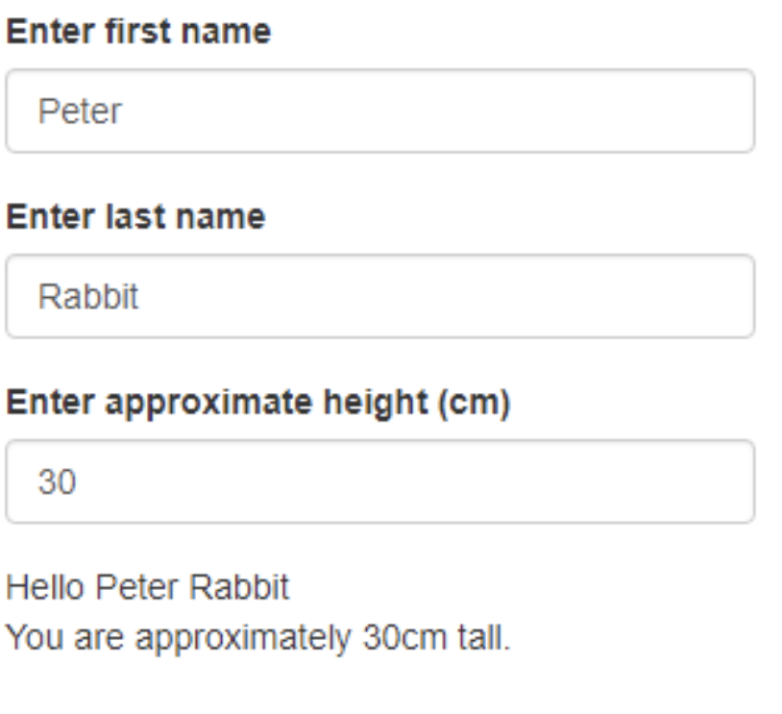
Exercise 5
Create a Shiny application from scratch that looks (and functions) like the one below.
There should be 2 textInput fields for entering user names, and one numericInput for entering height
The message at the bottom should display the first and last names entered by the user, along with their height
Add some radio buttons to allow users to select age brackets
Change the height selector to a slider
Feel free to add extra info fields

Slide 3
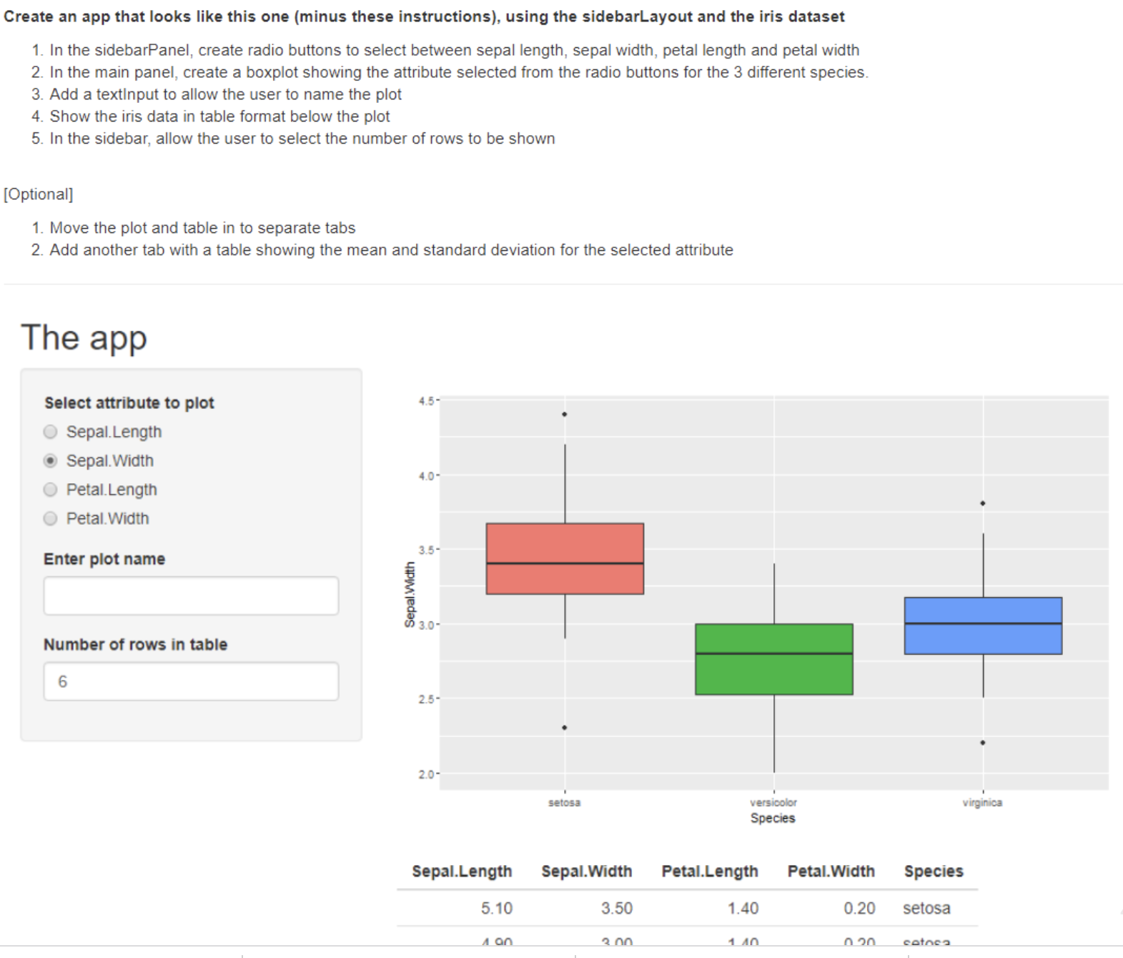
Exercise 6 – to do at home

Slide 4
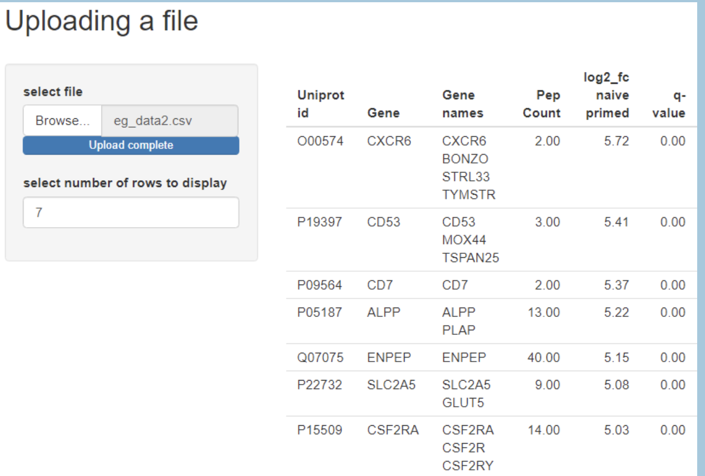
Exercise 7
Uploading a file.
Create an app that looks like this one. It should: - allow a csv file to be chosen and uploaded - display the first few rows of data in a table - have an option to change the number of rows displayed

Slide 5
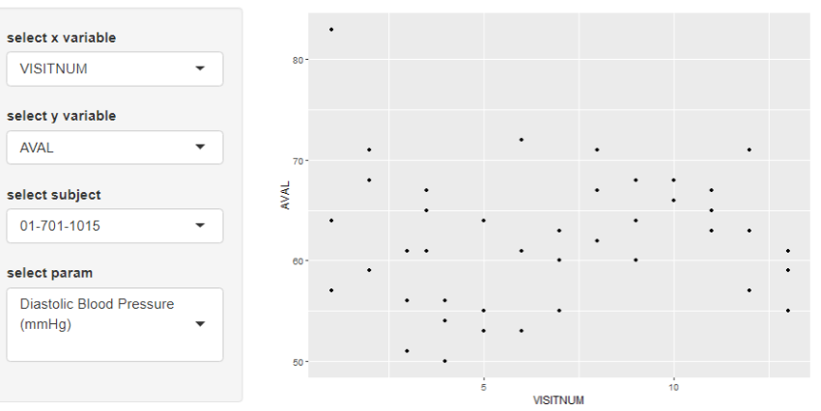
Exercise 8
Create an app that looks like this one, it should:
Import the advs.csv file.
Provide drop down lists of variables to plot on x and y axes.
Filter data based on the selected subject and parameter.

Slide 6
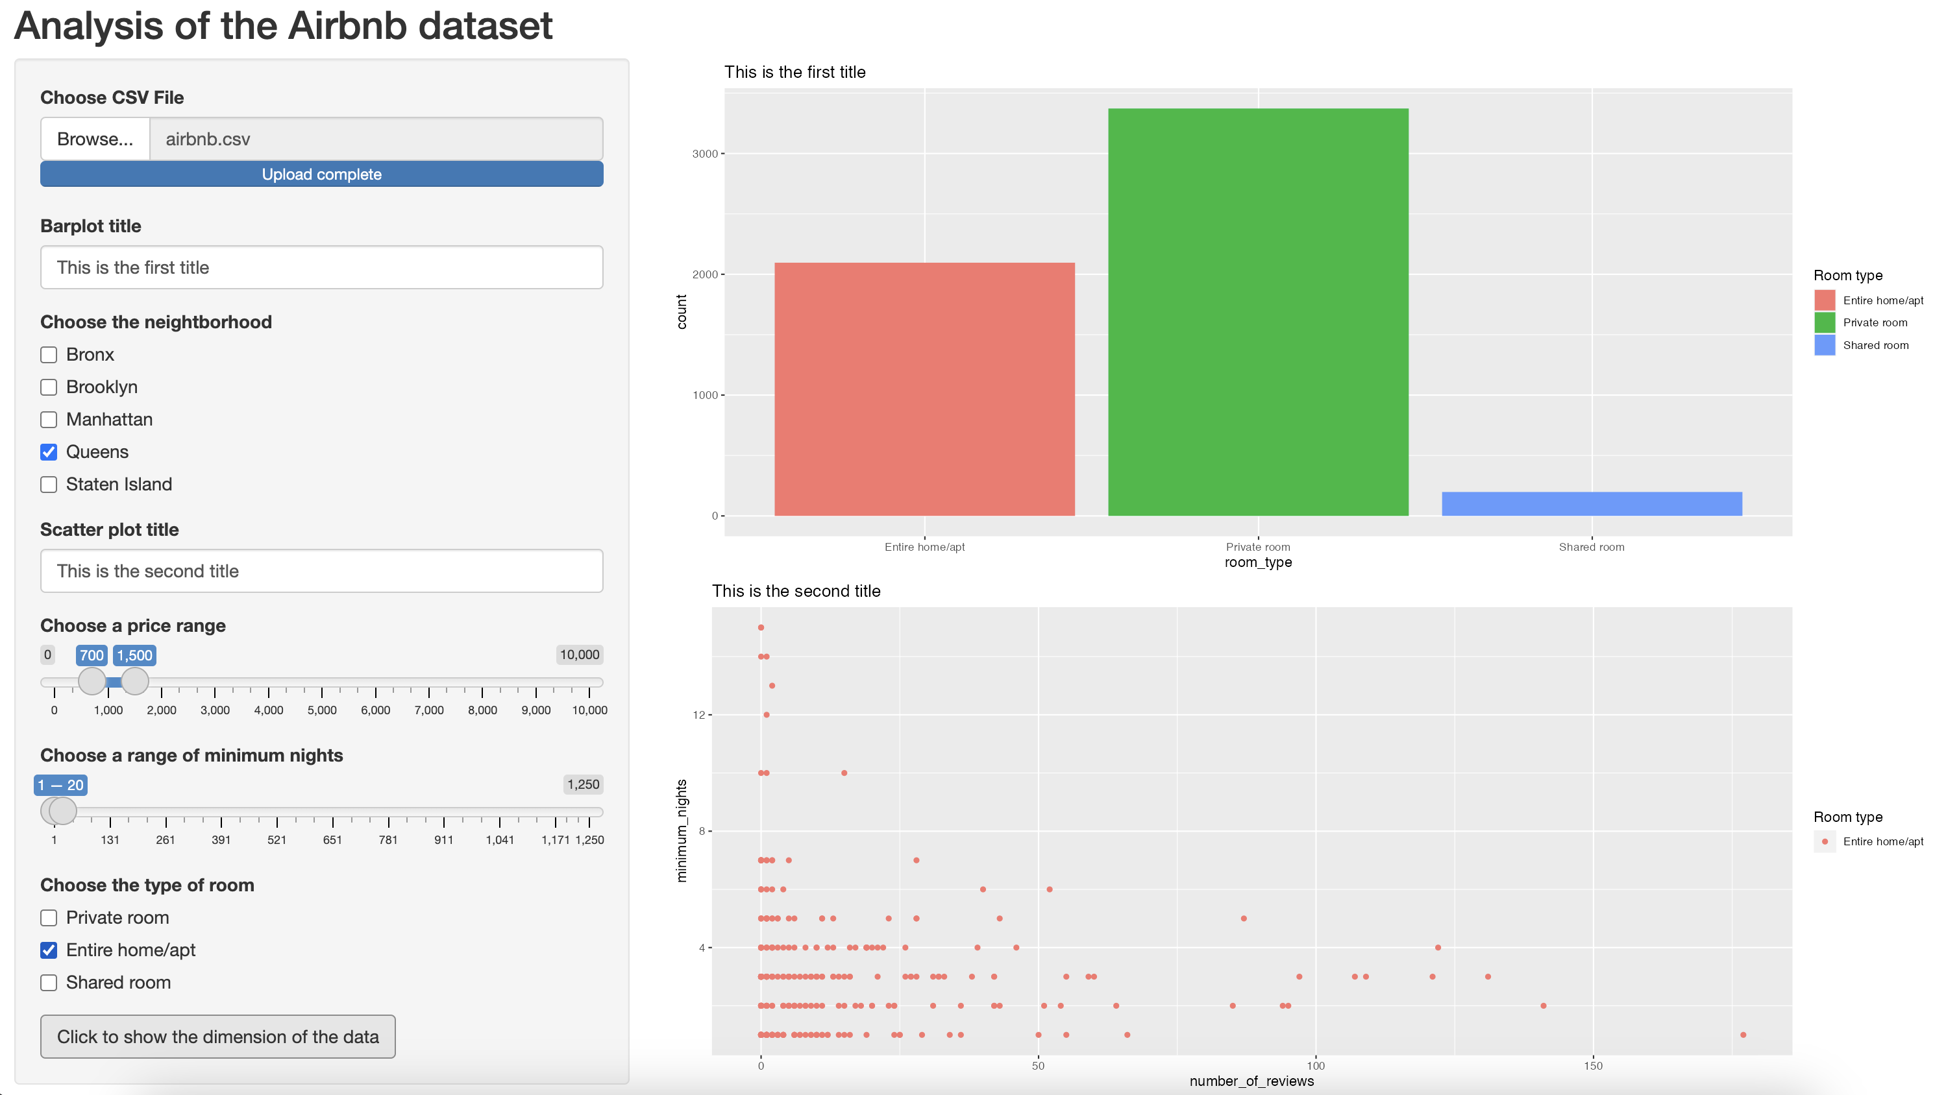
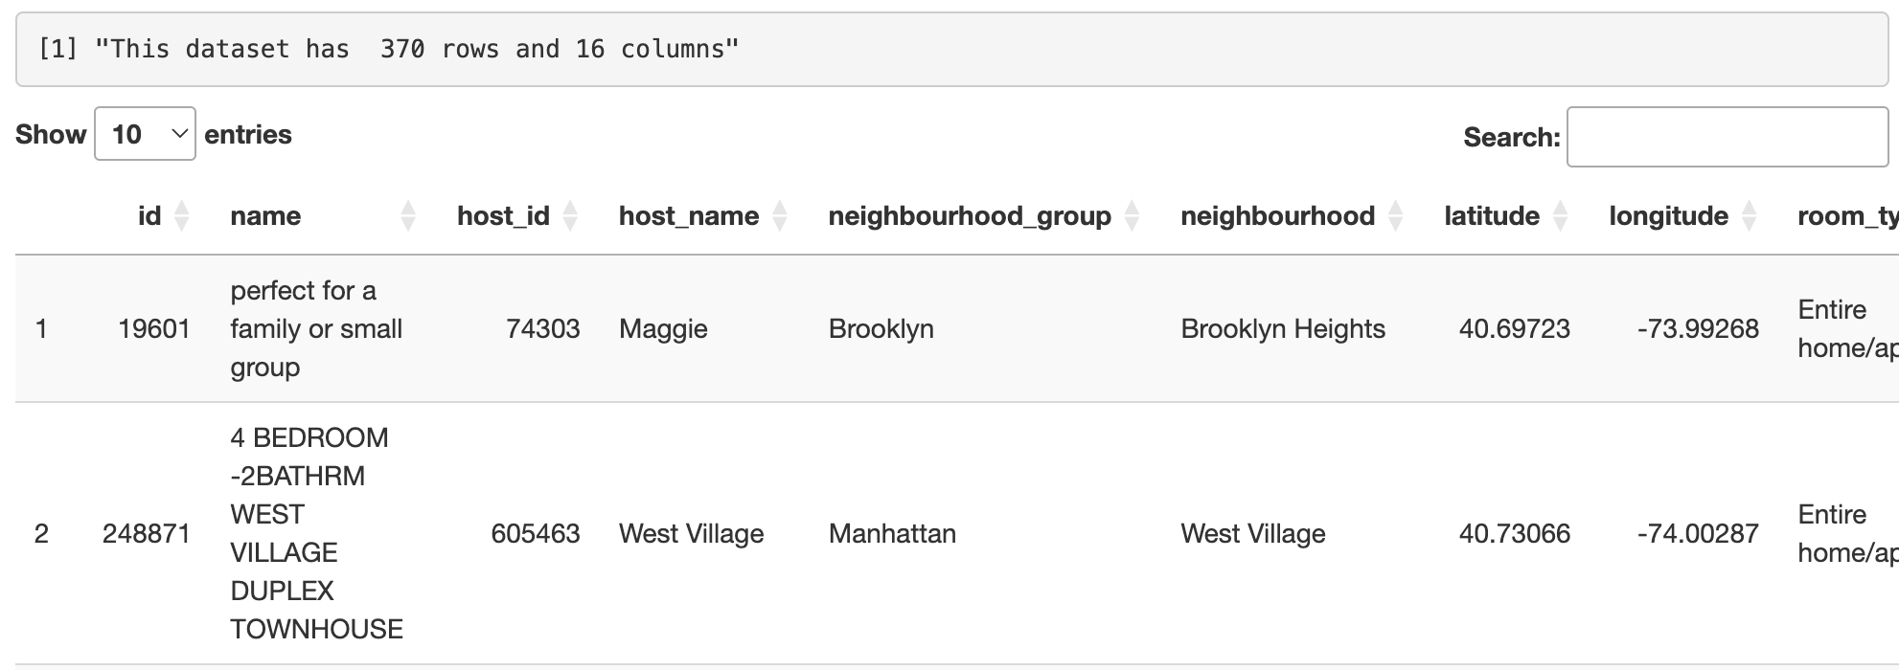
Exercise 9
Create an app that looks like this one, it should:
Import the airbnb.csv file.
Filter data based on price range, range of minimum nights and the room type
Plot out a barplot of the room type depending on neighborhood group selected
Plot out a scatterplot of the number of reviews and minimum nights selected
Add a button “Click to show the dimension of the data » such that if you click it, the dimension of the data represented in the scatterplot are shown.

